Slide 1

Attrition Case Study

Slide 2
OBJECTIVE
Attrition is widely understood to be one of the major problems affecting organizations today. In this project, we will study various factors that leads employees to leave the company. The goal of this project is to predict employee attrition using machine learning algorithms so that organization can take steps to keep their employees satisfied.
We will use hypothetical data of employees of an organization.

Slide 3
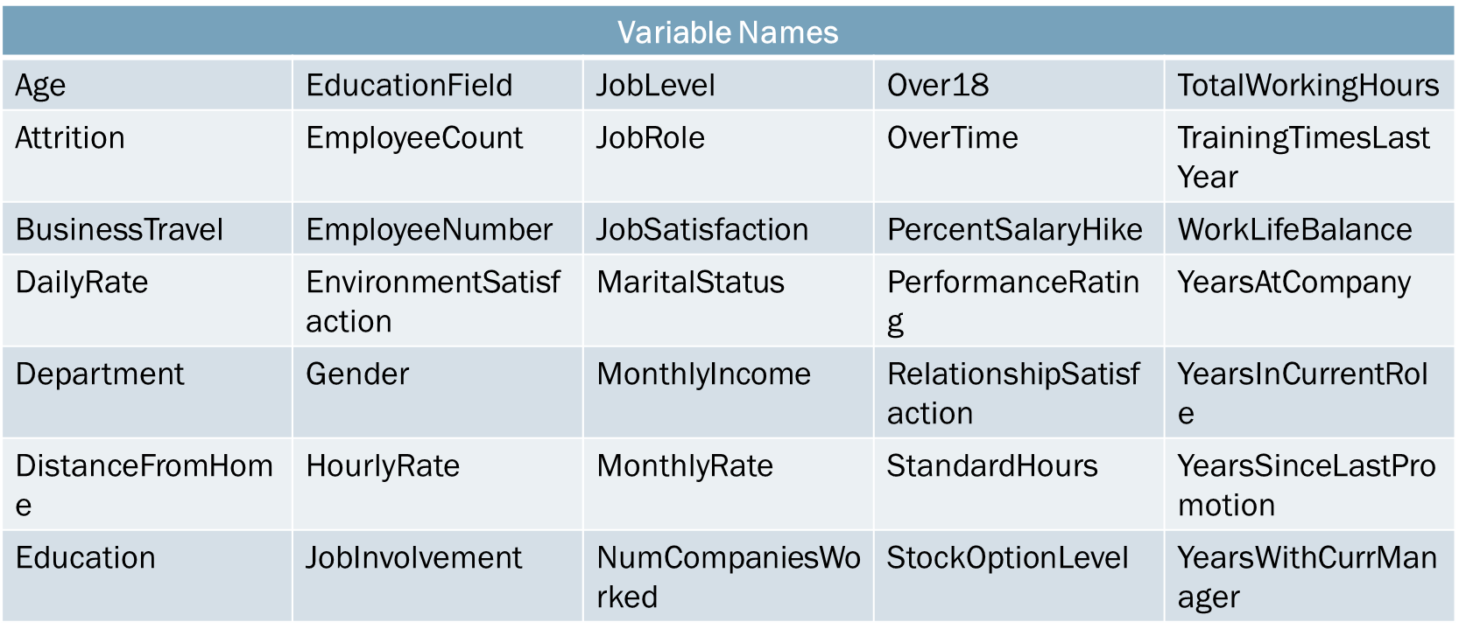
Dataset Description:
The data consists of 1470 observation and 35 variables about employee’s statistics, their
evaluation about the company and attrition result.
The variables are as following:

Slide 4
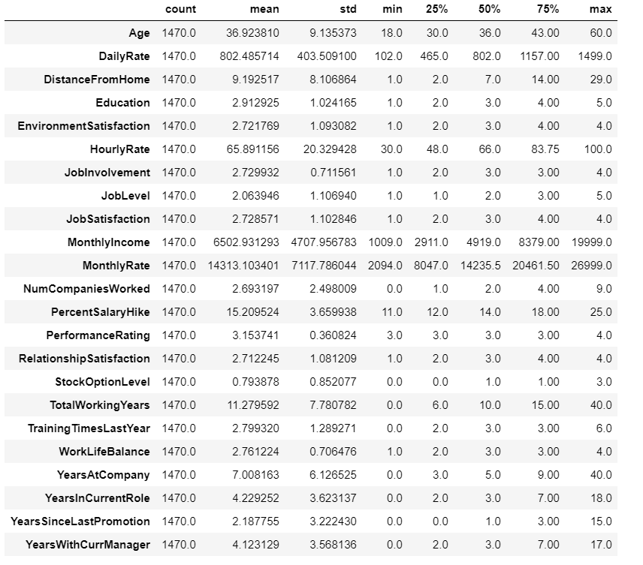
Data Preprocessing and EDA
Descriptive statistics:

Slide 5
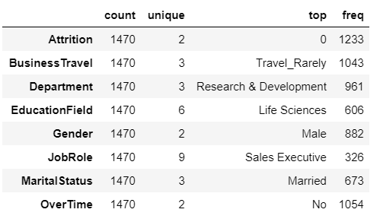

Slide 6
Data Cleaning:
Detecting missing values: the dataset does not consist of any missing value.
Detecting outliers: The dataset dos not onsist of outliers.
Removing insignificant variables: The following variables consists of unary values and contributes nothing to our analysis, so we directly remove them:
EmployeeCount
Over18
StandardHours

Slide 7
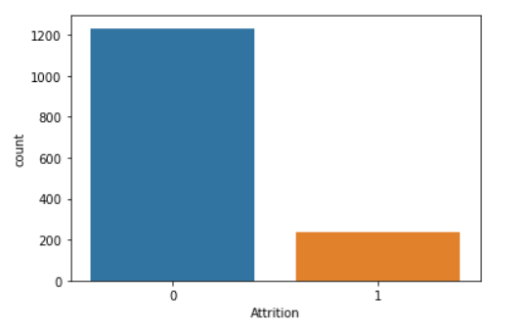
Data Visualisation:
Distribuition of attrition is highly imbalanced. About 237 out of 1470 employees tend to leave the company which is approximately 16% of total number of employees

Slide 8
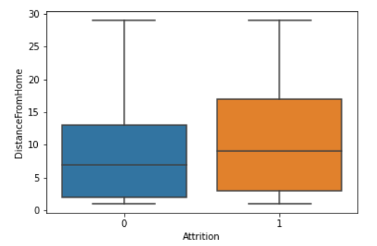
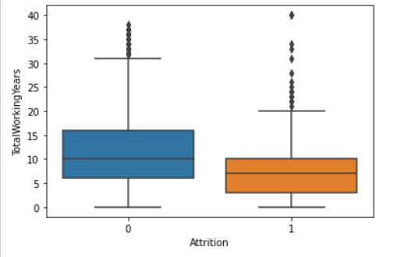
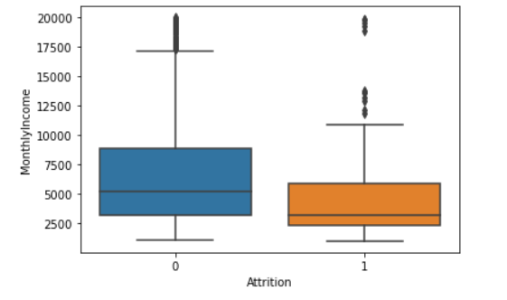
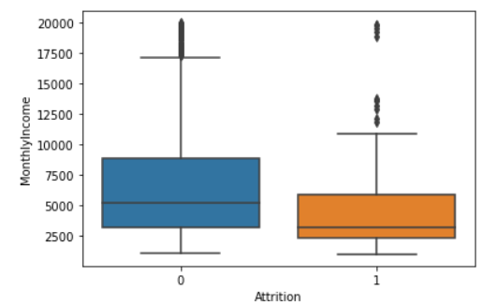
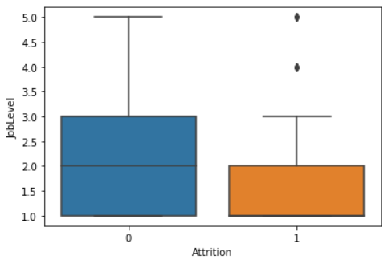
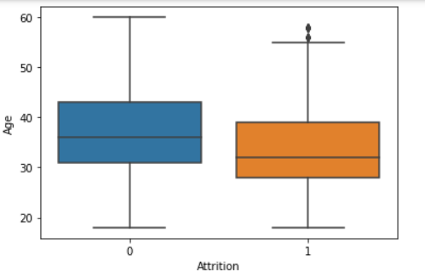
Visualising continuous variables against attrition

Slide 9
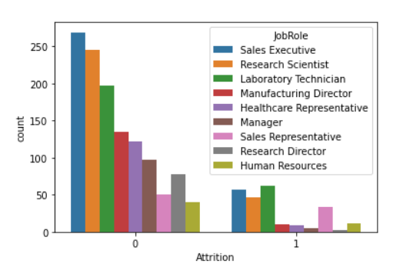
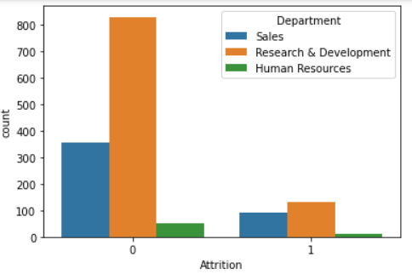
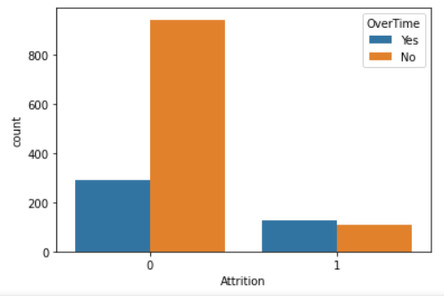
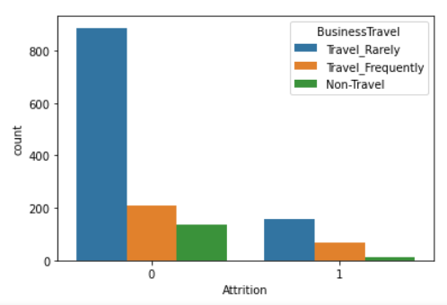
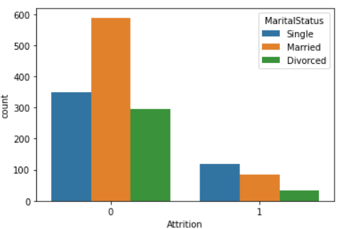
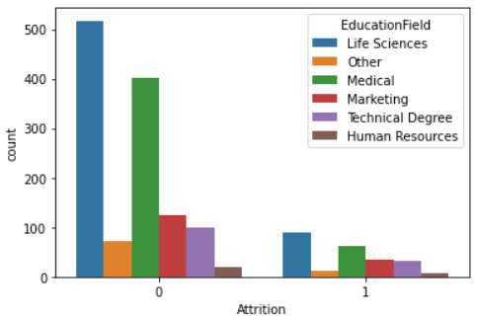
Visualising categorical variables against attrition

Slide 10
Statistical significant numerical features:
The employees lost in attrition have 3-4 years average age less than those who stayed.
The daily rate of employees who left had average daily rates less than those who stayed.
The employees who left had average commute distance more than those who stayed.
The employees who left were less satisfied with their work environment on average.
The job involvement level for employees who left is less on average than those who stayed.
The employees lost in attrition belonged to lower job level on average than those who stayed.
The employees who left were less satisfied with their job.
The average monthly income of employees who left the company is less than those who stayed.
The employees who left worked for less years in the company on average than those who stayed.
The employees who left were given less stock option levels on average
The employees lost in attrition had less training opportunities than those who stayed.

Slide 11
The employees who left had poor work life balance on average.
The employees who stayed worked for more years in their current role on average than those who left.
The employees who left worked under their current manager for less years on average than those who stayed.
The employees who left had a less chance for business travel.
The employees under job role Laboratory Technician, Sales Executive, Sales Representative are more who left the organization.
The employees who does overtime tends to leave the organization
Single employees tends to leave the organization
The average monthly income of sales and HR department is more from R&D department
The average monthly income for employees under job role laboratory technician, Research Scientist and Sales Representative is comparatively less.

Slide 12
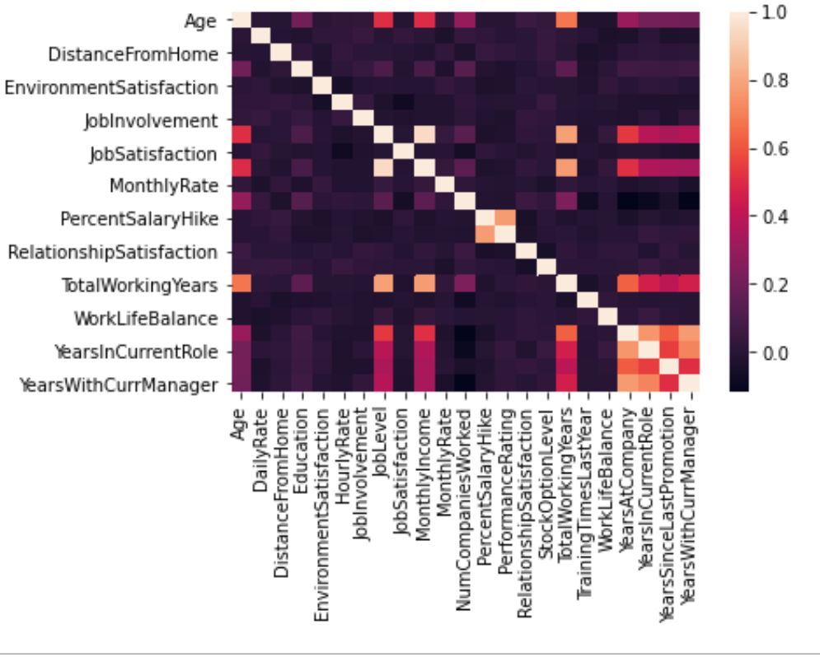
Correlation analysis:

Slide 13
Inference from correlation analysis:
Job level and monthly income are positively correlated which means that the monthly income for higher job level employees is comparatively more
Performance rating and percent salary hike are positively correlated i.e the employees with high performance rating gets more salary hike.
Total working years and monthly income are positively correlated.
Total working years and job level are correlated i.e job level increases with increase in working years.

Slide 14
Predicting Attrition
Convert categorical variables to dummy variables
Splitting data to train and test
Balance target data : we have used SMOTE technique in our model

Slide 15
Performance metrics for different Models used:
Model | Accuracy Score | Precision | ROC_AUC
Logistic Regression | 0.765 | 0.327 | 0.736
KNN | 0.806 | 0.45 | 0.69
Decision Tree | 0.813 | 0.46 | 0.69
Max depth | 0.802 | 0.44 | 0.679
Min Leaf | 0.809 | 0.44 | 0.70
Random forest | 0.881 | 0.83 | 0.806

Slide 16
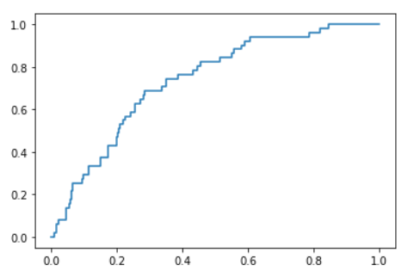
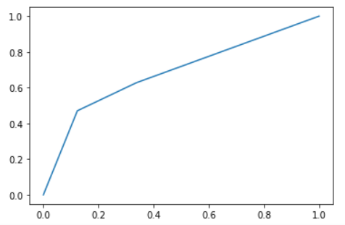
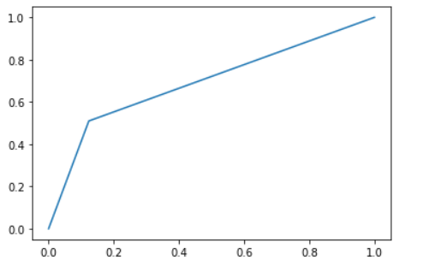
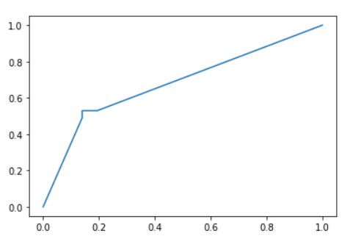
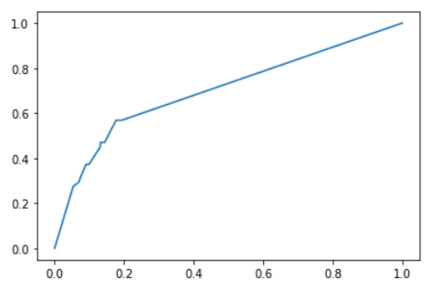
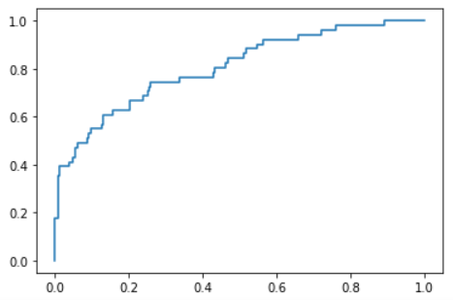
ROC curve for different models:
Logistic Regression
KNN
Decision Tree
Max Depth
Min Leaf
Random Forest

Slide 17
Conclusion:
The goal for this dataset was to find out what are the characteristics of the employees that are most likely to leave their jobs. After due data exploration we uncovered the patterns and relationships between predictors. We implemented different classification models. And random forest gives the best results out of all the models.

